Slide 1

Airbnb Rental Price Prediction San Francisco
INFO 7390 Advances in Data Sciences and Architecture
Submitted by:
Aditi Krishna
Pranshu Dixit
Shreya Patil

Slide 2

Introduction
Airbnb is an online marketplace that connects people who want to rent out their homes with people who are looking for accommodations in specific locales
In big cosmopoliton cities with a lot of tourism, landlords move their properties out of the long-term rentals and for-sale markets, and into the short-term rental market by turning their rooms and properties into short-term lets which offers an alternative and lucrative source of revenue
The prices of these properties should be optimally set, given the demand and the property-specific features

Slide 3
Problem and About the Dataset
Airbnb price prediction is a supervised machine learning regression problem
We aim to build the best model using linear regression, ridge regression, linear support vector regressors, k-nearest neighbours, and random forests. We tune the hyperparameters for few of the models
The performance of each of these models are evaluated and compared
Dataset: “Inside Airbnb” is an independent, non-commercial organization that collects scraped data that allows you to explore how Airbnb is being used in cities around the world
We aim to predict the prices for Airbnb in San Francisco, CA

Slide 4
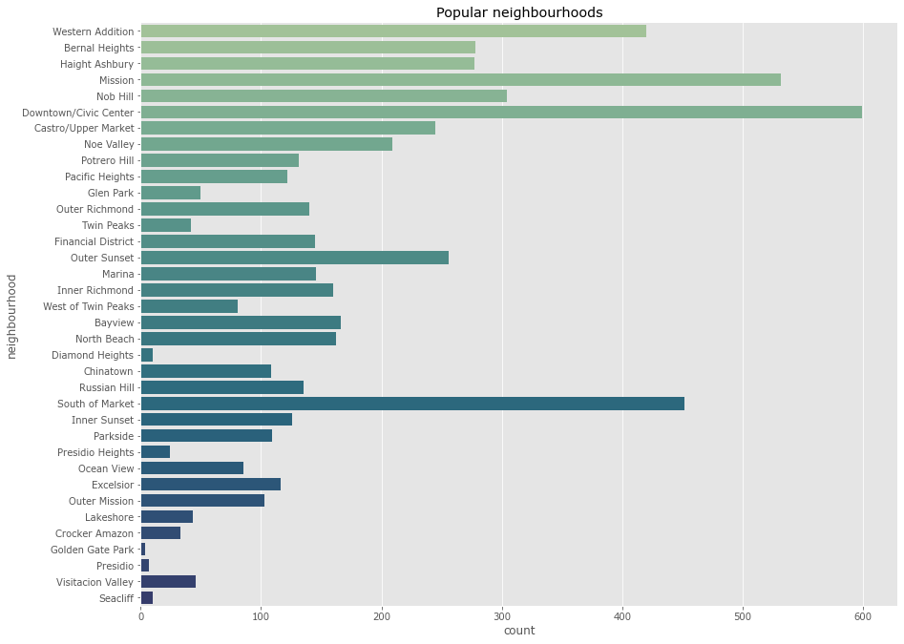
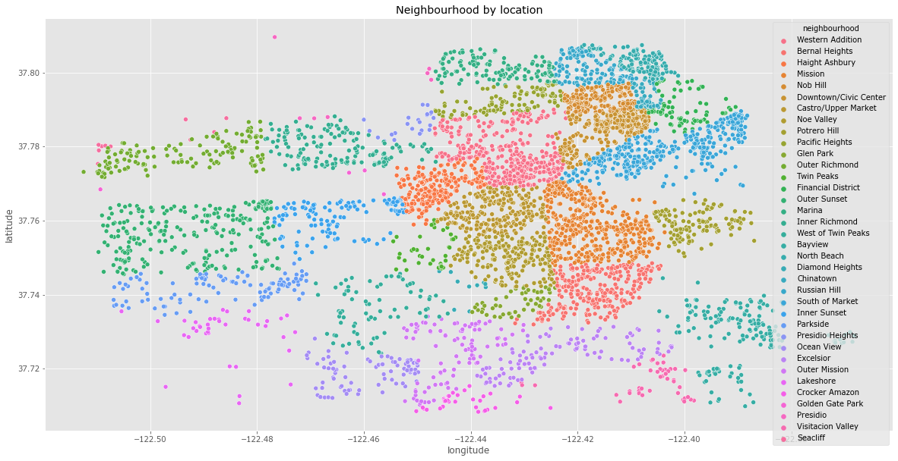
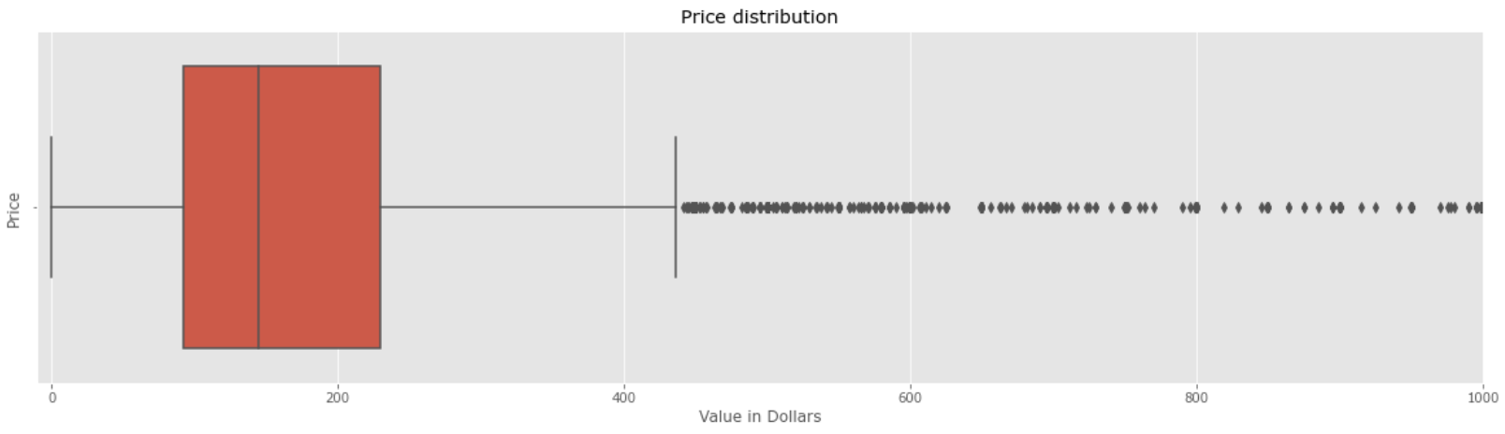
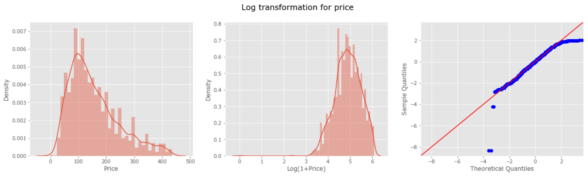
Exploratory Data Analysis
Feature Engineering:
Dropping features, missing value treatment
Processing highly cardinal features
One-hot-encoding for categorical variables
Correlation analysis with heatmap
Analyzing number of hosts vs number of properties
Analyzing popular neighbourhoods and properties
Analyzing skewness - price, reviews per month
Neighbourhood cluster by latitude and longitude

Slide 5
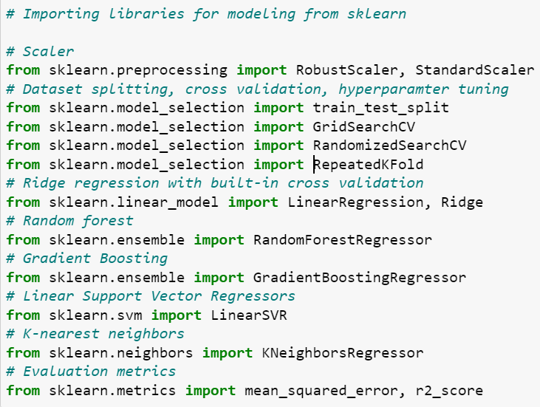
Models and Packages
Algorithms used:
Linear regression
Ridge regression
Linear support vector regressors
K-nearest neighbours
Random forests
We also perform hyperparameter tuning to attain the best results for our models
Packages used:
Sklearn, statsmodels,
Seaborn, matplotlib
Numpy, Pandas

Slide 6
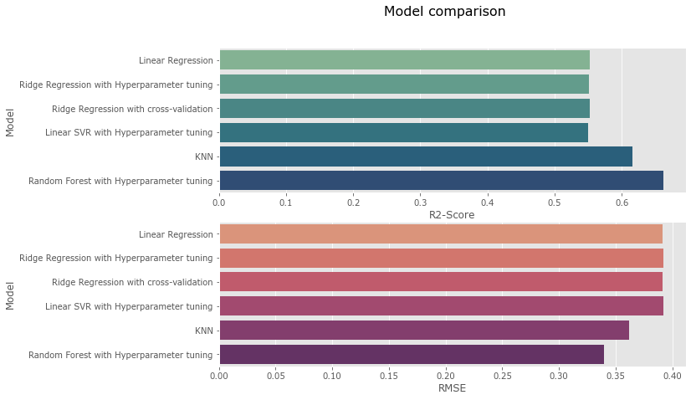
Model Evaluation Metrics
We use R2-score and RMSE score to compare the model performances
Random forest with hyperparameter tuning has the lowest RMSE value of 0.33, and has the highest R2-score of 0.66. It clearly is the best performing model
The second best performing model is KNN, which is a non-parametric supervised machine learning algorithm, with R2-score of 0.61 and RMSE value of 0.36

Slide 7
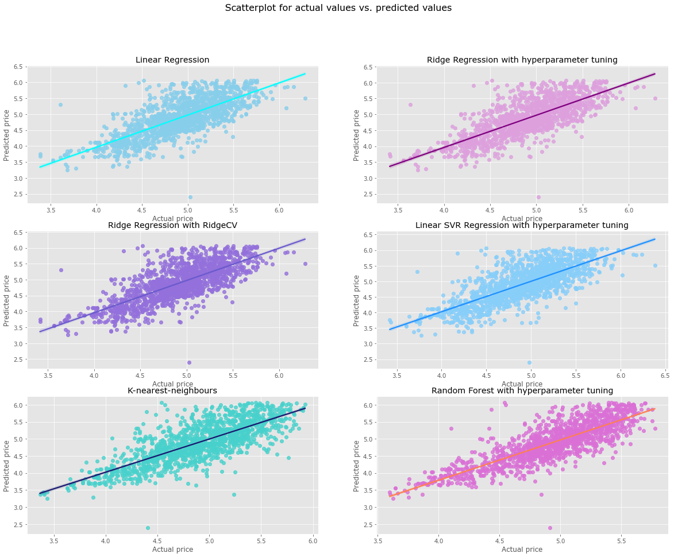
Results and Conclusion
The prediction results could possibly have been better if there were more predictor variables, such as the number of rooms, bathrooms, proximity to tourist spots, proximity to local transport, proximity to subway station, etc.
Random Forest and KNN were found to be the best performing models

